Slide 1
Port Forwarding and Shell Login Essentials
lctseng

Slide 2
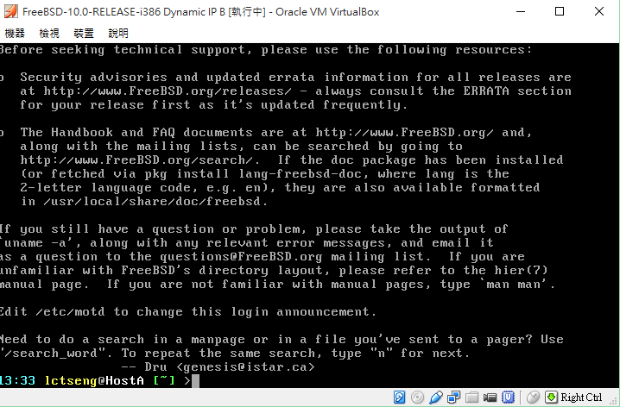
The Console
Screen you see when installing the system

Slide 3
The Console
The monitor of a computer
Enter commands by your hands
No interaction with your host OS
Host OS: running VirtualBox/VMware
No select, copy, paste, etc.

Slide 4
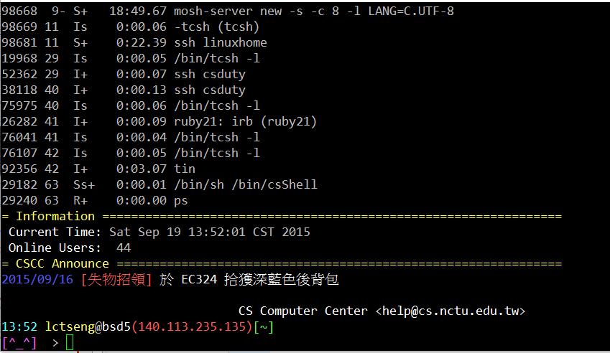
Using Remote Shell Login
Using Putty
A secure shell login(ssh) client
Allows you to login into Unix-like system
Like connecting to with CS workstations

Slide 5
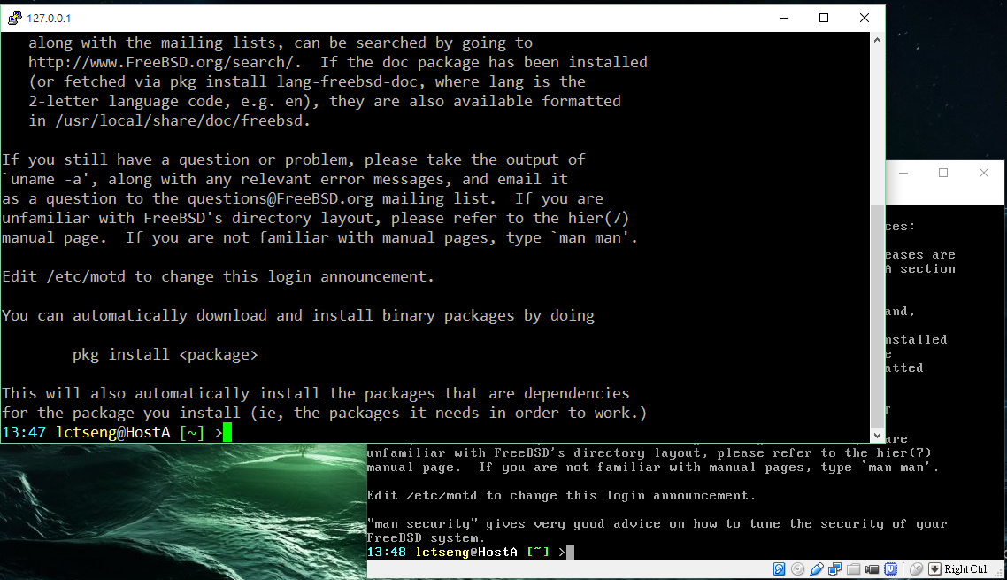
Using Remote Shell Login
After proper configuration

Slide 6
Using Remote Shell Login
Interactions: select, copy, paste, etc.
Copy commands from your screen
Copy some long commands from other place
Change the appearance
Fonts, opacity, encoding, etc.
Display non-ASCII characters
E.g. Chinese
Allow from remote login
Don’t need to bring your computer going around
Text interface only
No GUI, X windows, …

Slide 7
Using Remote Shell Login: Architecture
Connect to CS workstation
No problem
SSH connection
(140.113.235.135)
(TCP 22 port)
Putty
(your computer)
bsd5.cs.nctu.edu.tw

Slide 8
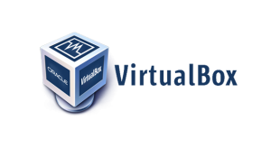
Using Remote Shell Login: Architecture
Connect to your own VMs
Connect to which host?
22 port
VM 1
?
22 port
SSH connection
(127.0.0.1)
(TCP ?? port)
VM 2
Putty
(Host OS)
22 port
VM 3

Slide 9
Port Forwarding
Create an internal table
Specific which port match which VM
22 port
VM 1
TCP 8022 port
TCP 9022 port
22 port
VM 2
Putty
(Host OS)
TCP 10022 port
VM 3
Usage | Host IP | Host port | VM | VM port
SSH #1 | 127.0.0.1 | 8022 | VM 1 | 22
SSH #2 | 127.0.0.1 | 9022 | VM 2 | 22
SSH #3 | 127.0.0.1 | 10022 | VM 3 | 22
22 port

Slide 10
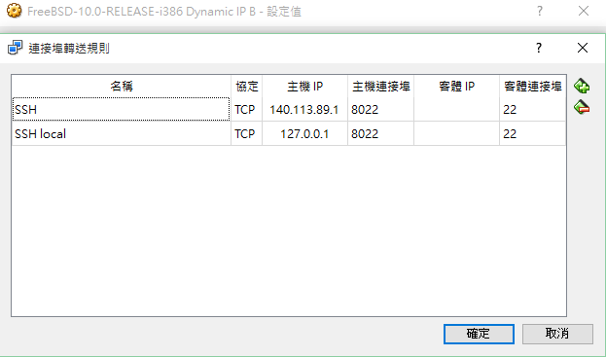
Setup Port Forwarding in VirtualBox
What we want:
Open a port to connect to VM’s TCP 22 port
Choose an unused port and pair them
Some versions of VirtualBox need only one entry (specific no IP)
For remote connection
For local connection only
(safer)

Slide 11
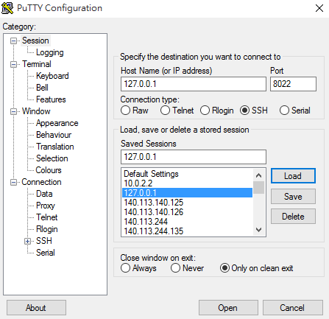
Setup Port Forwarding in VirtualBox
Local connection
After setting an entry with IP 127.0.0.1 (assume port = 8022)

Slide 12
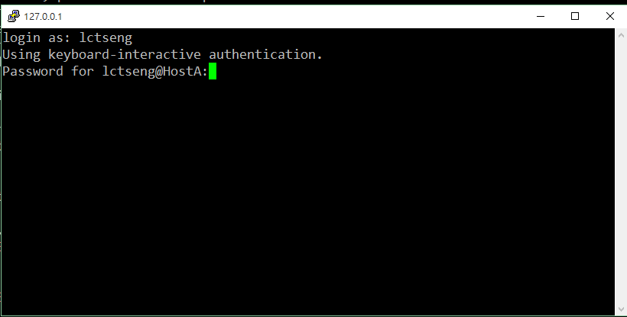
Setup Port Forwarding in VirtualBox
Local connection
Now you can login into your VM

Slide 13
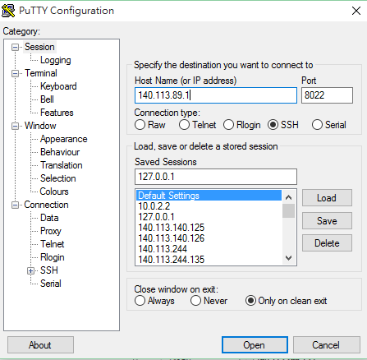
Setup Port Forwarding in VirtualBox
Remote connection
After setting an entry with IP 140.113.89.1 (assume port = 8022)

Slide 14
Setup Port Forwarding in VirtualBox
Remote connection problems
Connection refused
Connection timeout
Firewall
Allow 8022/9022/<ports you set> for inbound traffic
Turn off firewall
DANGER!! DO ON YOUR OWN RISK!

